Slide 1

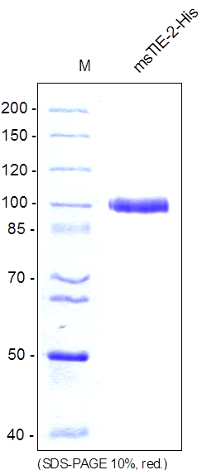
Reliatech GmbH
Mouse soluble TIE2-His (Insect cells)
(Cat# S01-043 / S01-044))
Figure 1: SDS-PAGE analysis of recombinant mouse sTIE-2 produced in insect cells. Sample was loaded in 10% SDS-polyacrylamide gel under reducing conditions and stained with Coomassie blue.
http://www.reliatech.de / orders@reliatech.de

